Slide 1
Lecture 2 : Software Process and Software Process Models

Slide 2
Some Terminologies
2
Software process refers to the set of activities (like designing, developing, and testing) used to create a software system.
Software process model is a simplified, abstract representation of that process.
SDLC (Software Development Life Cycle) also commonly called Software process: the overall, structured process for building and maintaining software
Software development model is a specific, abstract framework that defines the stages and activities within the SDLC.

Slide 3
Software Process: Software Development lifecycle (SDLC)
Presented by – Manohar Prasad

Slide 4
Software (Engineering) Process
A set of activities and associated results that produce a software product.
A structured set of activities used to develop a software system/product.

Slide 5


Slide Title
• Make Effective Presentations
• Using Awesome Backgrounds
• Engage your Audience
• Capture Audience Attention
The SDLC is a framework that describes the activities performed at each stage of a software development project.
SDLC process is used by the software industry to design, develop and test high quality software. It aims to produce the quality software that meets or exceeds customer expectations, reaches completion within time and budget.

Slide 6
ISO/IEC 12207 is an international standard for software life-cycle processes. It aims to be the standard that defines all the tasks required for developing and maintaining software.
Software Engineering Process Technology Company, (SEPT) is a firm specializing in meeting the software process standards information needs of the professional community, particularly concerning ISO/IEC 12207.
International Electrotechnical Commission (IEC)
International Organization for Standardization (ISO)
For more info visit http://www.12207.com/
Slide Title
• Product A • Product B
• Feature 1 • Feature 1
• Feature 2 • Feature 2
• Feature 3 • Feature 3
• Feature 4 • Feature 4

Slide 7
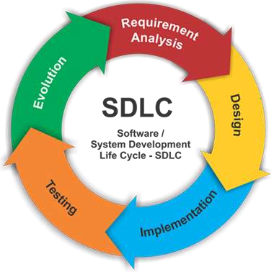
SDLC Phases:

Slide 8
SDLC Phases
Planning and Requirements Analysis
Defining Requirements
Designing the Software
Building or Developing the Software
Testing the Software
Deployment and Maintenance

Slide 9
Many different software processes but all involve Requirements specification
Software specification
Definition of the software to be produced and the constraints of its operation.
Software development
Design and implementation of the software.
Software validation
To ensure that the software does what the customer requires.
Software evolution
Adaptation and modification of the software to cope with changing customer and market requirements.

Slide 10
1. Planning & Requirement Analysis
Requirement analysis is the most important and fundamental stage in SDLC.
It is performed by the senior members of the team with inputs from all the stakeholders and domain experts or SMEs in the industry.
Planning for the quality assurance requirements and identification of the risks associated with the project is also done at this stage.

Slide 11
Requirements Analysis
Business Requirements
Stakeholder Requirements
Solution Requirements
Functional Requirements
Non-functional Requirements
Transition Requirements

Slide 12
2. Defining Requirements
Once the requirement analysis is done the next step is to clearly define and document the software requirements and get them approved from the project stakeholders.
This is done through ‘SRS’ – Software Requirement Specification document which consists of all the product requirements to be designed and developed during the project life cycle.

Slide 13
Defining Requirements
Enterprise Analysis
Business Analysis Planning & Monitoring
Elicitation
Requirements Analysis
Requirements Management & Communication
Solution Assessment & Validation

Slide 14
3. Designing the Software
Based on the requirements specified in SRS, usually more than one design approach for the product architecture is proposed and documented in a DDS - Design Document Specification.
This DDS is reviewed by all the stakeholders and based on various parameters as risk assessment, design modularity , budget and time constraints , the best design approach is selected for the software.

Slide 15
4. Developing the Software
In this stage of SDLC the actual development starts and the product is built. The programming code is generated as per DDS during this stage.
Developers have to follow the coding guidelines defined by their organization and programming tools like compilers, interpreters, debuggers etc are used to generate and implement the code.

Slide 16
5. Testing the Software
This stage is usually a subset of all the stages as in the modern SDLC models, the testing activities are mostly involved in all the stages of SDLC.
However this stage refers to the testing only that stage of the software where defects are reported, tracked, fixed and retested, until the software reaches the quality standards defined in the SRS.

Slide 17
6. Deployment and Maintenance
Once the software is tested and no bugs or errors are reported then it is deployed.
Then based on the feedback, the software may be released as it is or with suggested enhancements in the target segment.
After the software is deployed then its maintenance starts.

Slide 18
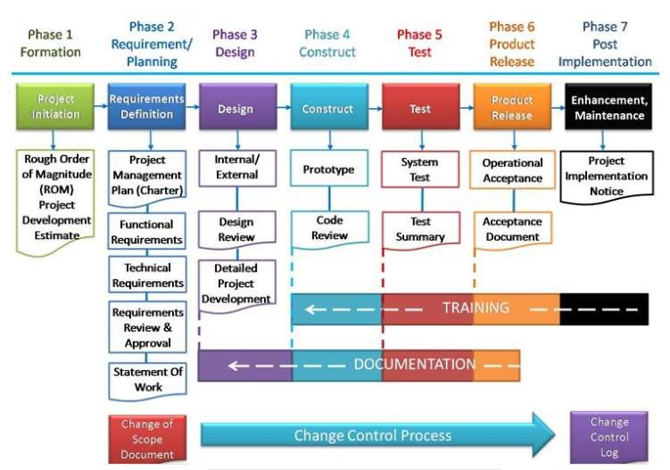


Slide 19
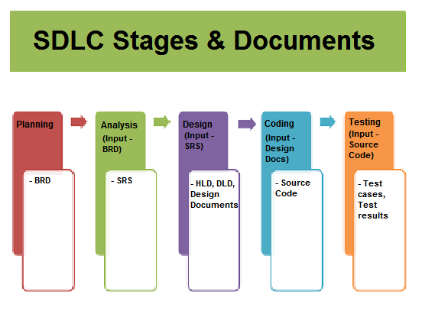
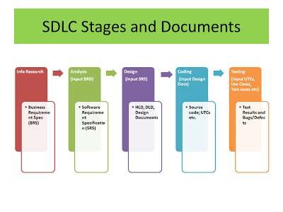

Slide 20
Advantages of Choosing Appropriate SDLC
Increased development speed
Increased product quality
Improved tracking & control
Improved client relations
Decreased project risk
Decreased project management overhead

Slide 21
Software process descriptions
Process descriptions may include process activities such as specifying a data model, designing a user interface, etc. and the ordering of these activities.
Process descriptions may also include:
Products: the outcomes of a process activity (models, docs)
Roles: the responsibilities of the people involved in the process;
Pre- and post-conditions: statements that are true before and after a process activity has been enacted or a product produced.

Slide 22
Software (Engineering) Process Models
Software (Engineering) Process Models are simplified and abstract description of a software process that presents one view of that process.
Process models may include activities that are part of the software process, software products, e.g. architectural descriptions, source code, user documentation, and the roles of people involved in software engineering.
Examples:
The waterfall model
The spiral model
“V-Modell (XT)” (dt.)
eXtreme Programming
Agile model
…

Slide 23
SDLC Models
To help understand and implement the SDLC phases, various SDLC models have been created by software development experts, universities, and standards organizations.

Slide 24
Reasons for Using SDLC Models
Provides the base for project planning, estimating & scheduling.
Provides framework for standard set of terminologies, activities & deliverables.
Provides mechanism for project tracking & control.
Increases visibility of project progress to all stakeholders.

Slide 25
SDLC Models
1. Waterfall Model
2. Iterative Model
3. Spiral Model
4. Agile Model
5. V – Model
6. Big Bang Model
1. Waterfall Model
2. Iterative Model
3. Spiral Model
4. Agile Model
5. V – Model
6. Big Bang Model

Slide 26
Large(r) projects may use different (multiple) software process models to develop different parts of the software.
4

Slide 27
The Waterfall Model

Slide 28
Oldest and most well-known SDLC model.
Follows a sequential step-by-step process from requirements analysis to maintenance.
Systems that have well-defined and understood requirements are a good fit for the Waterfall Model.

Slide 29
The Waterfall Model can be considered as a generic process model.
Requirements definition
1.Requirements analysis and definition
The requirements are established by consultation with system users.
After that they are defined in detail and serve as the system specification.

Slide 30
Waterfall model phases
There are separate identified phases in the waterfall model:
Requirements analysis and definition
System and software design
Implementation and unit testing
Integration and system testing
Operation and maintenance

Slide 31
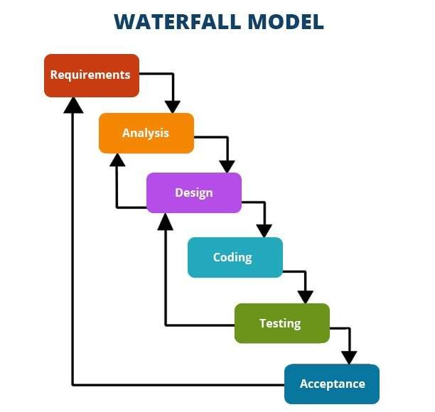

Slide 32




The Waterfall Model can be considered as a generic process model.
2.System and Software design The overall system architecture is defined. The fundamental software system abstractions and their abstractions are identified.
Requirements definition
System and software design

Slide 33



The Waterfall Model can be considered as a generic process model.
3.Implementation and unit testing
The software design is realized as a set of program units; testing verifies that each unit meets its specification.
Requirements definition
System and software design
Implementation and unit testing

Slide 34




The Waterfall Model can be considered as a generic process model.
4.Integration and system testing Program units are integrated and tested as a complete system.
Requirements definition
System and software design
Implementation and unit testing
Integration and system testing

Slide 35




The Waterfall Model can be considered as a generic process model.
Requirements definition
System and software design
Implementation and unit testing
Integration and system testing
Operation and maintenance

Slide 36















Key Properties of the Waterfall Model
The result of each phase is a set of artifacts that is approved.
The following phase starts after the previous phase has finished.
(In practice there might be some overlapping.)
In case of errors previous process stages have to be repeated.
Fits with other (hardware) engineering process models.
Requirements definition
System and software design
Implementation and unit testing
Integration and system testing
Operation and maintenance

Slide 37
Drawback of Waterfall model
The main drawback of the waterfall model is
the difficulty of accommodating change after the process is underway. In principle, a phase has to be complete before moving onto the next phase.
Inflexible partitioning of the project into distinct stages makes it difficult to respond to changing customer requirements.

Slide 38
Waterfall Model: Weaknesses
All requirements must be fully specified upfront
Deliverables created for each phase are considered frozen – inhibits flexibility
Can give a false impression of progress
Does not reflect problem-solving nature of software development – iterations of phases
Integration is one big bang at the end
Little opportunity for customer to preview the system (until it may be too late)

Slide 39
Waterfall Model: Strengths
Easy to understand, easy to use
Provides structure to inexperienced staff
Milestones are well understood
Sets requirements stability
Good for management control (plan, staff, track)
Works well when quality is more important than cost or schedule

Slide 40
Therefore, this model is only appropriate when the requirements are well-understood and changes will be fairly limited during the design process.
Few business systems have stable requirements.
The waterfall model is mostly used for large systems engineering projects where a system is developed at several sites.
In those circumstances, the plan-driven nature of the waterfall model helps coordinate the work.
Waterfall model problems

Slide 41
Advantages and Disadvantages of Waterfall model
ADVANTAGES
DISADVANTAGES
It is difficult to define all requirements at the beginning of the project.
The model is not suitable for accommodating any change.
A working version of the system is not seen until late in the project’s life.
•
It is a linear and segmental model.
Due to its simple and sequential nature it is easy
•
to understand even by the inexperienced
programmer.
Because of the non existing inter dependencies
•
of the different stages,
the
no complicated team members is
•
coordination among necessary.
•
Documentation makes the process visible so
managers can monitor progress against the development plan

Slide 42
When to use Waterfall Model
This model is used only when the requirements are very well known, clear and fixed.
Product definition is stable.
Technology is understood.
There are no ambiguous requirements
Ample resources with required expertise are available freely

Slide 43
END
34

